Slide 1
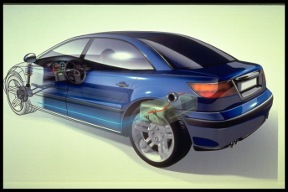

Automotive and industrial vehicles applications

Slide 2
Rilsan® coating
Rilsan® coating system competitively replaces
Polyester-Epoxy
and other Paints
Plastic Overmoldings
Rilsan ®
Thermal Treatment :
Case Hardening
Chemical Treatment :
Hard Chromium Plating
Nickel Plating

Slide 3
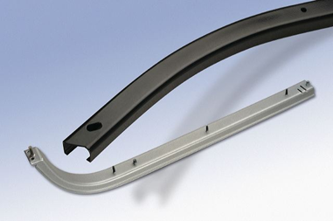
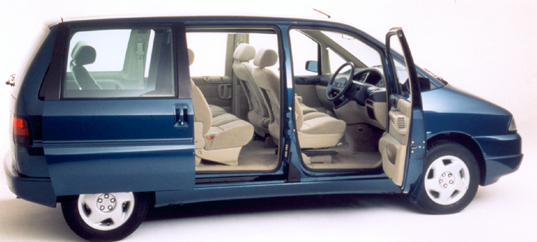
Case file: Sliding door rails
Qualified for:
Minivans/passenger cars opening door sliding systems
Grades :
ES Black 625 MACA, ES Black 710 MAC
Main reasons for choosing Rilsan®:
Resistance to compression and abrasion
Low coefficient of friction : vibration & noise control
Protection against corrosion, chemical resistance
Good weathering properties (UV, temperature)
Nice surface finishing
Cost competing solution vs. stainless steel

Slide 4
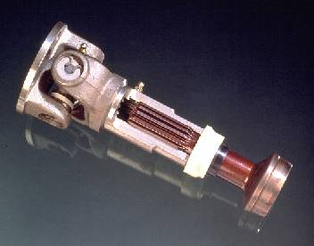
Case file: Spline / drive shafts
Qualified for :
Medium/Heavy & Light trucks transmissions
Tractors power take-off
Grades :
T Nat BHV2, T colored BV/HV
ES Black 820 MAC
Main reasons for choosing Rilsan® :
Solution homologated for 40 years
Outstanding abrasion resistance. Chemical resistance to oil & fluids
Noise and vibration control
Excellent creep resistance under load
Easy processing (no sagging, good edge covering) & easy broaching

Slide 5
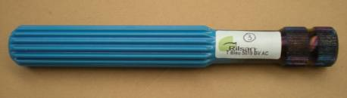

Case file: Steering shafts
Qualified for :
Telescopic passenger cars steering columns
Grades :
T Nat BHV2, T colored BV/HV
Main reasons for choosing Rilsan® :
Low coefficient of friction over a wide temperature range
Decreases the motor effort required for electrical steering systems
Noise and vibration control
Easy broaching to achieve desired thickness
Flexible technology: applicable to any kind of design (competes with cost advantages vs. injection molding)

Slide 6
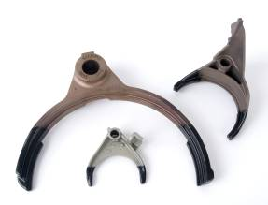
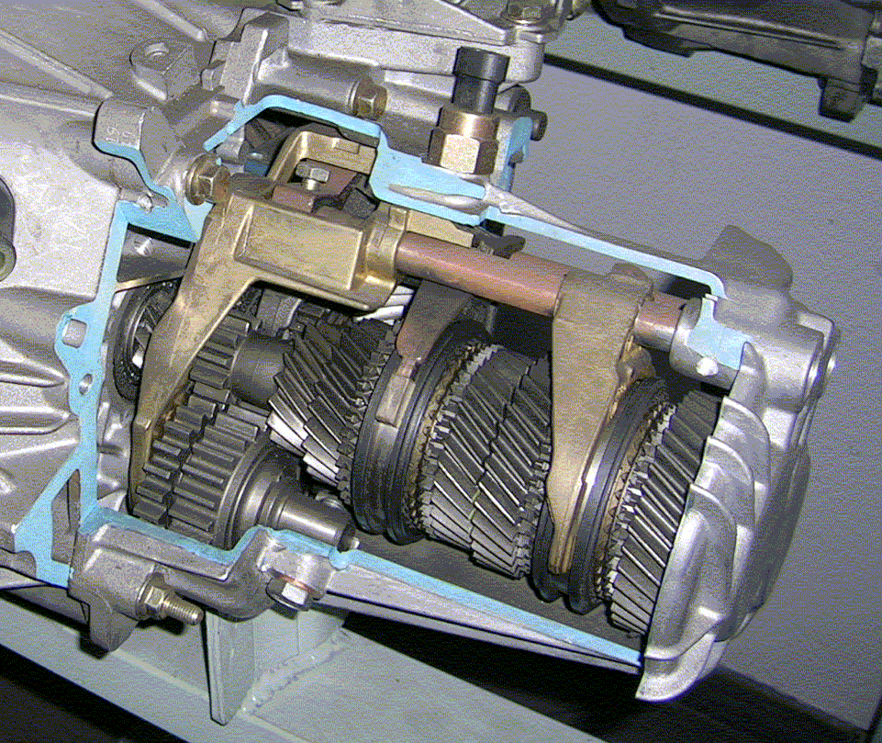
Case file: Gear Box Fork
Qualified for :
Tractors, Light trucks and Cars gearing boxes
Grades :
T Nat BHV2, T colored BV/HV
Main reasons for choosing Rilsan®:
Outstanding abrasion resistance (no wear)
Good mechanical (compression) resistance, over a large range of temperatures
Chemical resistance to oil & fluids
Less expensive solution :
  - 2 X less expensive than Flame Sprayed Molybdenum Wire
  - 10 X less expensive than Plasma coating with Molybdenum

Slide 7
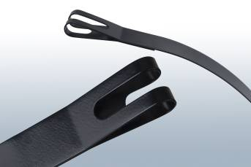
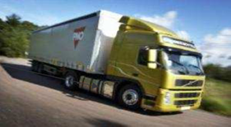
Case file: Strap band for trucks
Qualified for :
Heavy trucks straps for air / diesel & gas tanks
Grades :
ES Black 710 MAC
Main reasons for choosing Rilsan®:
Durable anti-corrosion protection (protects gas tank)
Stone chipping resistance
Bendability
Good weathering properties (UV, temperature)
Chemical resistance (brake liquid, fuel grease, salts…)
Cost competing solution vs. stainless steel

Slide 8
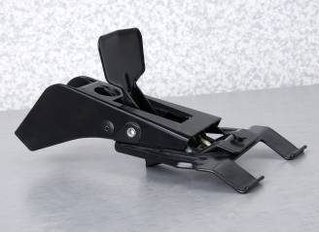
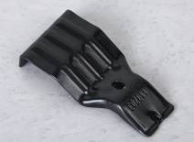
Case file: Roof racks
Qualified for :
load carriers systems
Grades :
Pebax® ES Black 9002
Main reasons for choosing Pebax®:
Softness. Protects exterior paint
Adhesion and tractional properties (grip)
Easy processing
Flexible technology: material is applicable to any kind of design (coated parts compete with cost advantages vs. injected molded parts)

Slide 9
Case file: Parts for “under the hood” environment
Qualified for :
Releasing and Safety systems (hood support, hood release)
Grades :
T Black 7450 AC, T Yellow 7473 AC,
T Yellow 7379 MAC, MC Black 820 MAC
Main reasons for choosing Rilsan®:
Resistance to wear and “micro-vibrations”
Good impact resistance
Productivity of coating process (maxicoat)

Slide 10
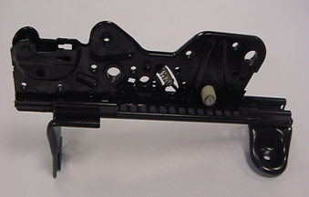
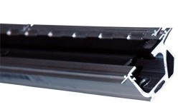
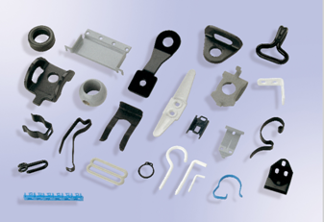
Case file: Interior Parts - Seat components
Qualified for :
Seat sliding systems of any type
Seat belt anchors. Hooks, clips, springs
Grades :
T Black 7450 AC, MC Black 820 MAC
ES Black 625 MACA
Main reasons for choosing Rilsan®:
Abrasion resistance
Vibration and noise reduction
Productivity of coating process (minicoat)
Attractive surface finish

Slide 11

Case file: Sun roof cables
Qualified for :
Roof opening mechanisms (endless screw cables)
Grades :
ES black 625 MACA
Main reasons for choosing Rilsan®:
Low coefficient of friction
Long term wear resistance
Performance over a wide range of temperatures

Slide 12
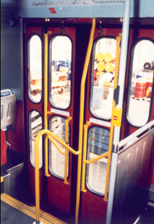
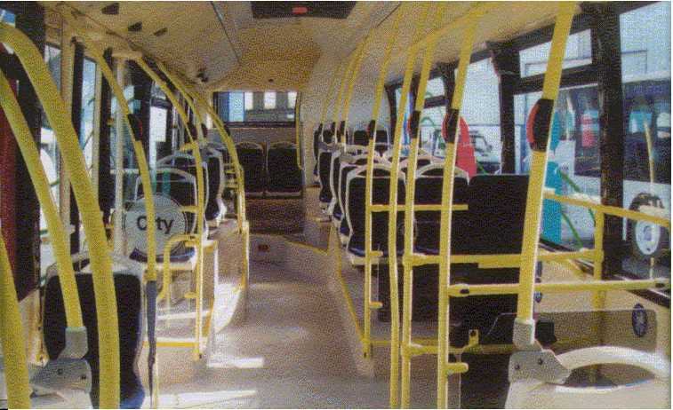
Case file: Handrails
Qualified for :
Public transportation (buses, trains, subway) equipments
Grades :
ES colored MAC, T colored MAC
Main reasons for choosing Rilsan®:
Smoothness, warm-to-the-touch surface
Abrasion resistance
Impact resistance
UV resistance
Cleaning agent resistance
Large choice of colours required by
municipalities & companies

Slide 13
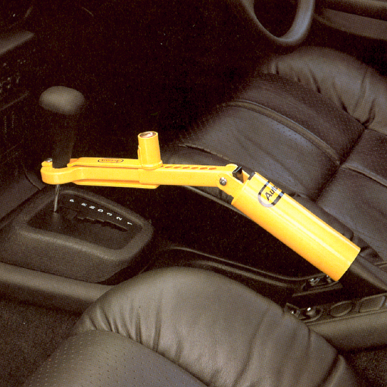
Case file: Anti-theft device
Qualified for :
Safety locking systems
Grades :
T colored MAC
Main reasons for choosing Rilsan®:
Abrasion resistance
Mechanical resistance
Smooth, warm-to-the touch surface

Slide 14
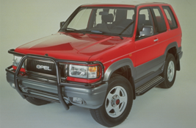
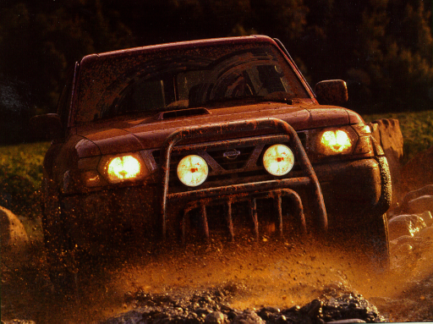
Case file: Nudge bars
Qualified for :
Vans & 4WD pick-up trucks front protection systems
Grades :
T Black 7450 AC
Main reasons for choosing Rilsan®:
High performance anti-corrosion solution
Stone chipping resistance
Resistance to outdoor exposure (UV resistance)

Slide 15

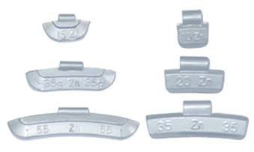
Case file: Wheel weights
Qualified for :
lead-free wheel weights, spared parts of all types
Grades :
MC Grey 49 MAC, ES Grey 49 MAC
Main reasons for choosing Rilsan®:
High corrosion protection
Stone shipping resistance
UV resistance
Bendability
Productivity of coating process (minicoat)

Slide 16
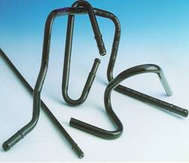
Case file: Tubes / fuel line
Qualified for :
“under the hood” fuel line tubing
Grades :
ES(Y) Black MAC
Main reasons for choosing Rilsan®:
Stone chip resistance
Coating’s adhesion
Finished tube processability (bending, flaring, etc...)
Chemical resistance (brake liquid, fuel grease, salts, etc….)
Competes with cross-head extrusion

Slide 17
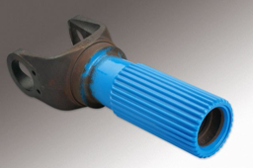
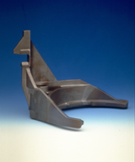
RFP : A large number of coating processes
Fluidized bed
Fluidized bed
Electrostatic
spraying
Minicoat
Minicoat
Spline
shafts
Drive
shafts
Gear box forks
Under the hood
parts
Interior parts
…

Slide 18
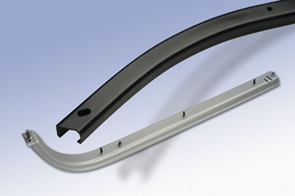
RFP : A large number of coating processes
Fluidized bed
Electrostatic
spraying
Minicoat
Sliding
door rails
Strap bands
Roof racks
Seat
components
Tubes / fuel
Lines
…

Slide 19
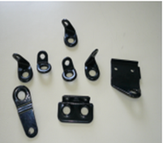
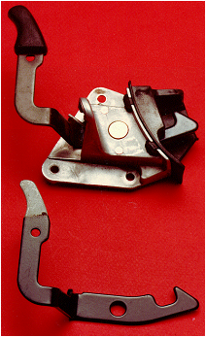
RFP : A large number of coating processes
Fluidized bed
Electrostatic
spraying
Minicoat
Seat
components
Under the hood
parts
Wheel weights
Interior parts
…

